Slide 1


APPLICATIONS OF LLM IN NLP
CCDS - NTU
DEC 2024
Welcome To NTU

Slide 2

Welcome to NTU
Workshop that will run from 10am to 2.45pm
Focused on NLP and its practical use cases

Slide 3
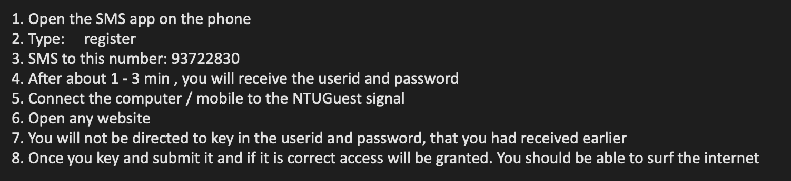
Welcome to NTU
Workshop that will run from 10am to 2.45pm
Focused on NLP and its practical use cases

Slide 4
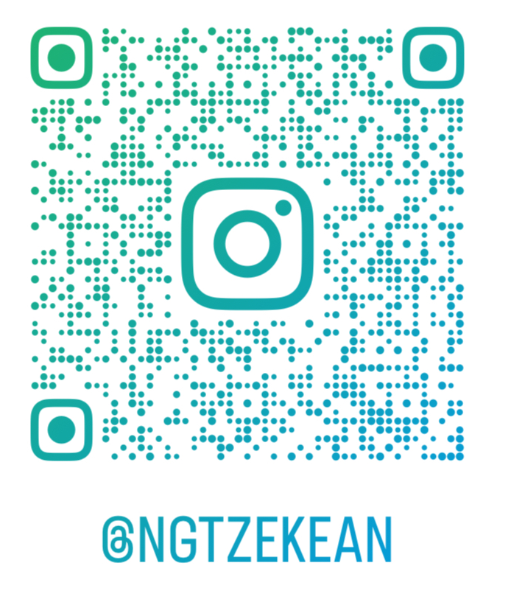
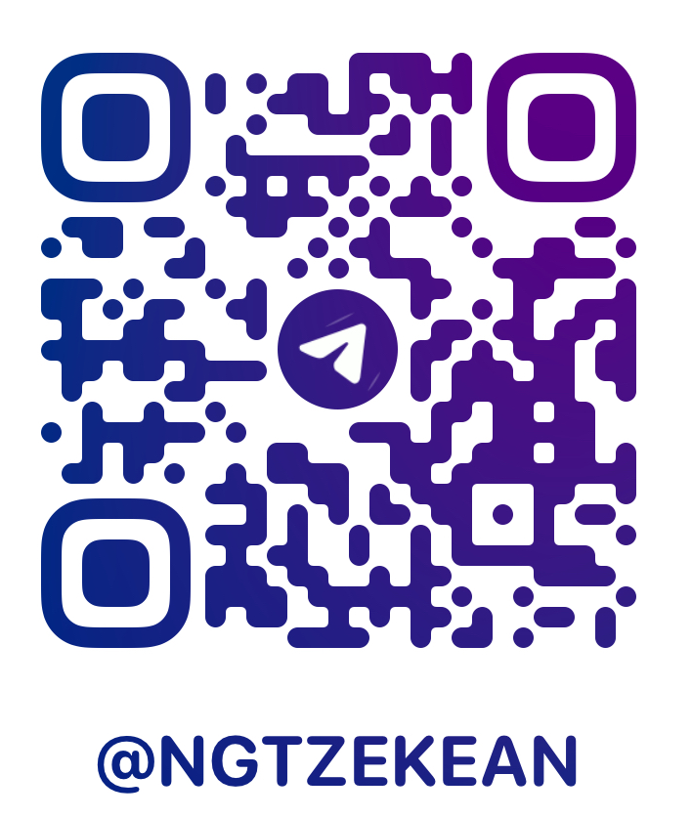

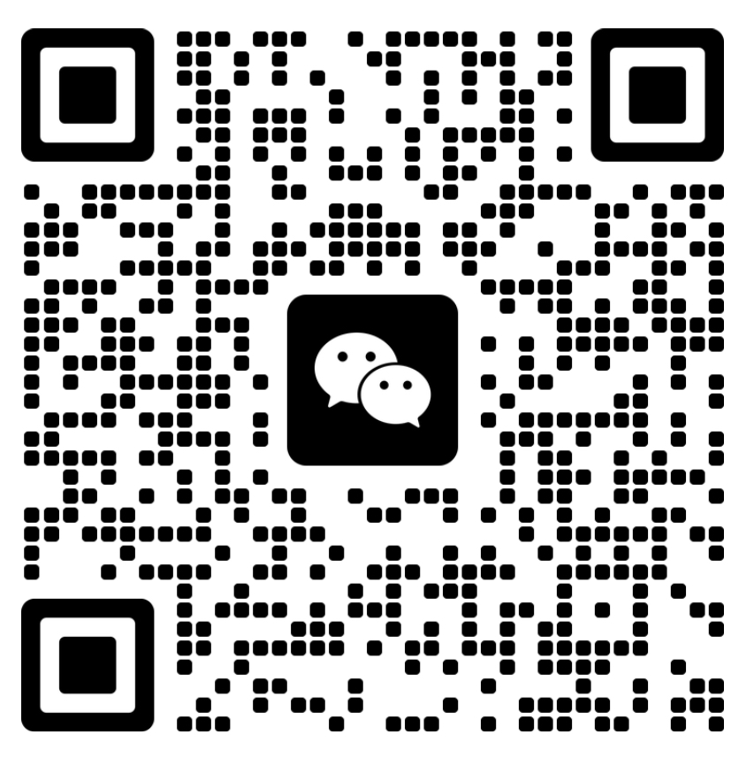
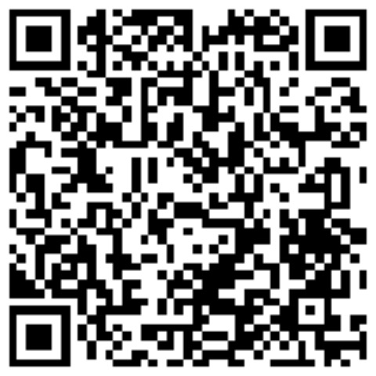
Ng Tze Kean
Insta
Tele
Github
Year 4 Computer Science
Minor in Business
CCDS/ COE/ GEM Ambassador
Aspiring to enter the finance industry!
WeChat
LinkedIn

Slide 5
Plan for today
Word2Vec workshop (1hour)
RNN workshop (30min)
RNN practical (30min)
Lunch break (45min)
LLM workshop (30min)
LLM practical (30min)

Slide 6
Plan for today
Word2Vec workshop (10:30)
RNN workshop (11:30)
RNN practical (12:30)
Lunch break (1:45)
LLM workshop (2.15)
LLM practical (2.45)

Slide 7
Question about NTU?
Student life
Internship
Hall
Studies

